Slide 1
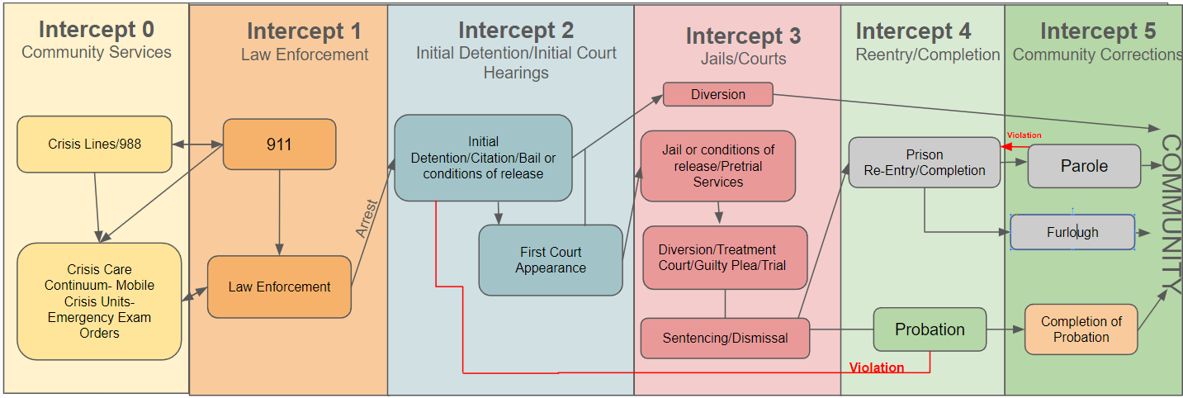
The Sequential Intercept Model (SIM)

Slide 2


Slide 3
CONTINUE
(Deeper into the judicial system)
INTERCEPT
(Away from courts and toward treatment / services / health resources)

Slide 4
The Sequential Intercept Model (SIM)
Access to Treatment and Other Key Services and Resources

Slide 5
The Need

Slide 6
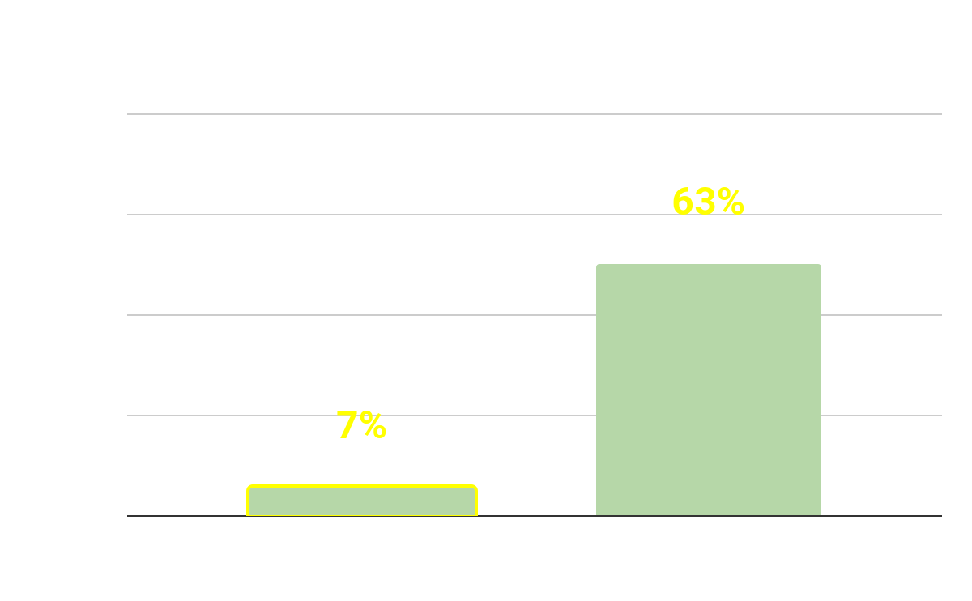
Intercept 3
Notes:
https://www.samhsa.gov/data/release/2017-national-survey-drug-use-and-health-nsduh-releases
https://www.samhsa.gov/criminal-juvenile-justice/about#:~:text=It%20is%20estimated%20that%2063,often%20incarceration%20exacerbates%20their%20symptoms.

Slide 7
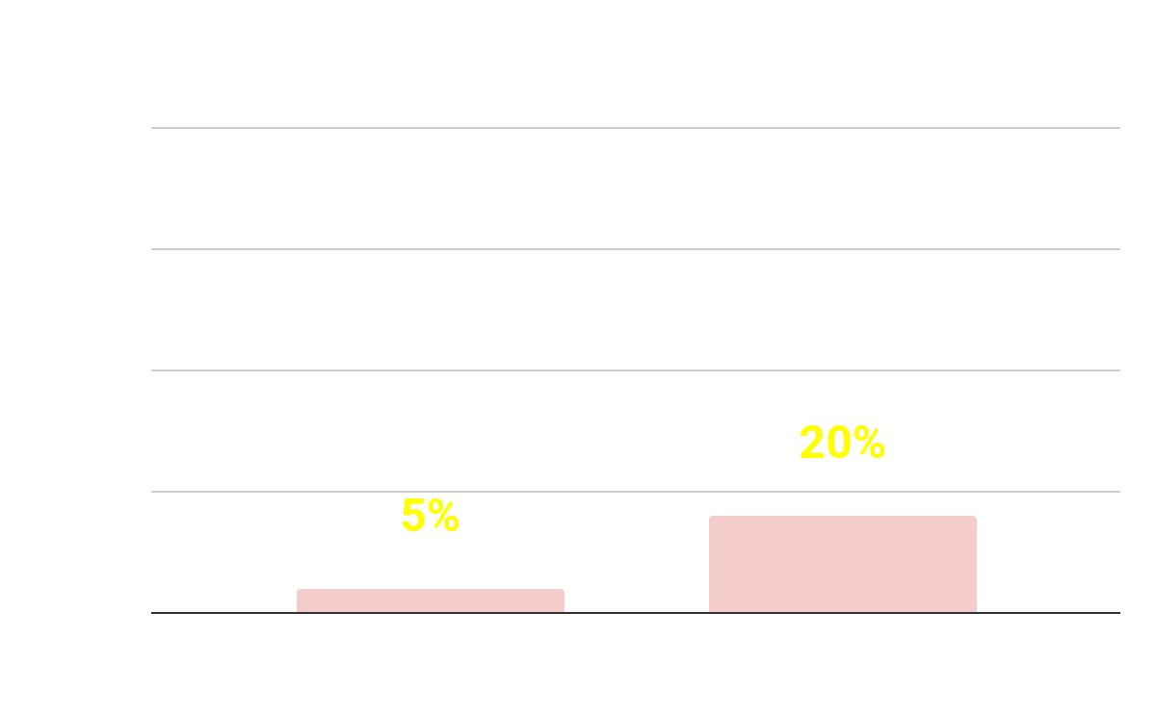
Intercept 3
Notes:
https://www.samhsa.gov/data/release/2017-national-survey-drug-use-and-health-nsduh-releases
https://www.samhsa.gov/criminal-juvenile-justice/about#:~:text=It%20is%20estimated%20that%2063,often%20incarceration%20exacerbates%20their%20symptoms.

Slide 8
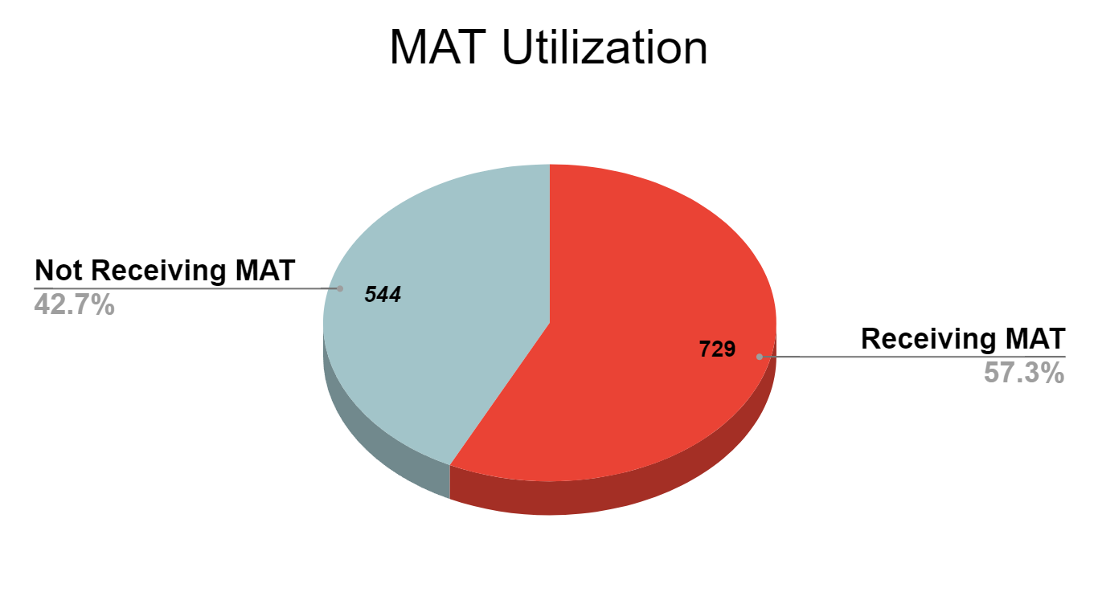
Dept. of Corrections: 3/31/2024 Snapshot
*Data Provided by publicly available VT DoC statistics
Intercept 3

Slide 9
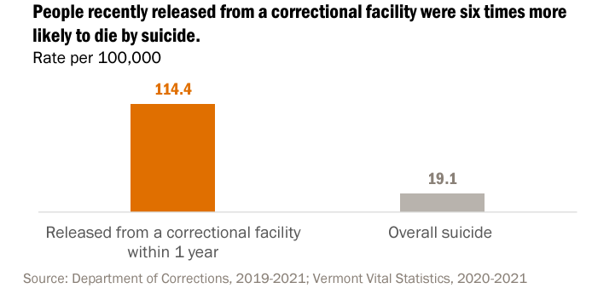
Intercept 5

Slide 10
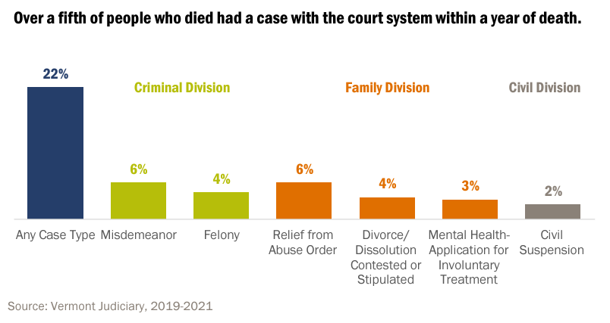
In VT, 22% of Those Who Died By Suicide Were Court-Involved

Slide 11
Suicide Risk Within One Year
All Vermont Adults 0.01%
Application for Emergency Treatment 0.60%
Civil Suspension 0.33%
Relief from Abuse Order 0.23%
Divorce/Dissolution (contested/stipulated) 0.23%
Felony 0.22%
Misdemeanor 0.09%
Notes:
Source: Vermont Judiciary, 2019-2021

Slide 12
“Of the “14 million or so people who experience the most debilitating mental health conditions, roughly one-third don’t receive treatment,” often because they cannot connect with the services they need, they lack insurance, or the services are not available.[15] The result is that people with serious mental illness “have been consigned to lives of profound instability” and, lacking proper care in the community, they often cycle through homeless shelters and periods of incarceration.[16]”
--New York State Bar Association
Notes:
https://nysba.org/unjust-punishment-the-impact-of-incarceration-on-mental-health/

Slide 13
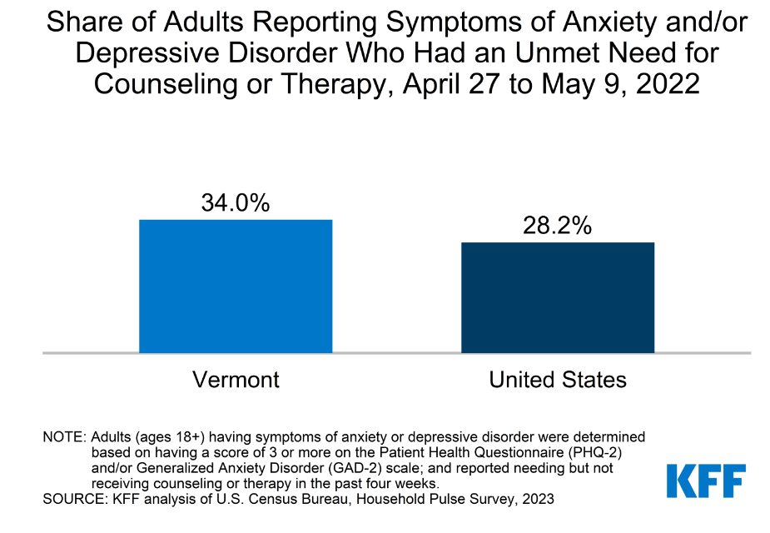
Intercept 1 and Others

Slide 14
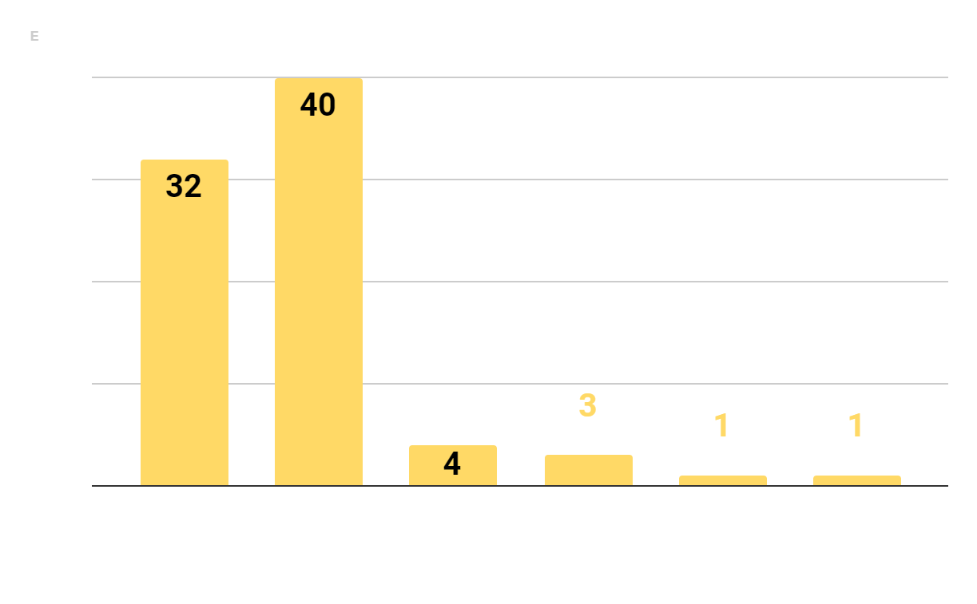
There is cross-system recognition that many adults involved with the justice system are experiencing mental health and substance use disorders[E]

Slide 15
Is there room for improvement?

Slide 16
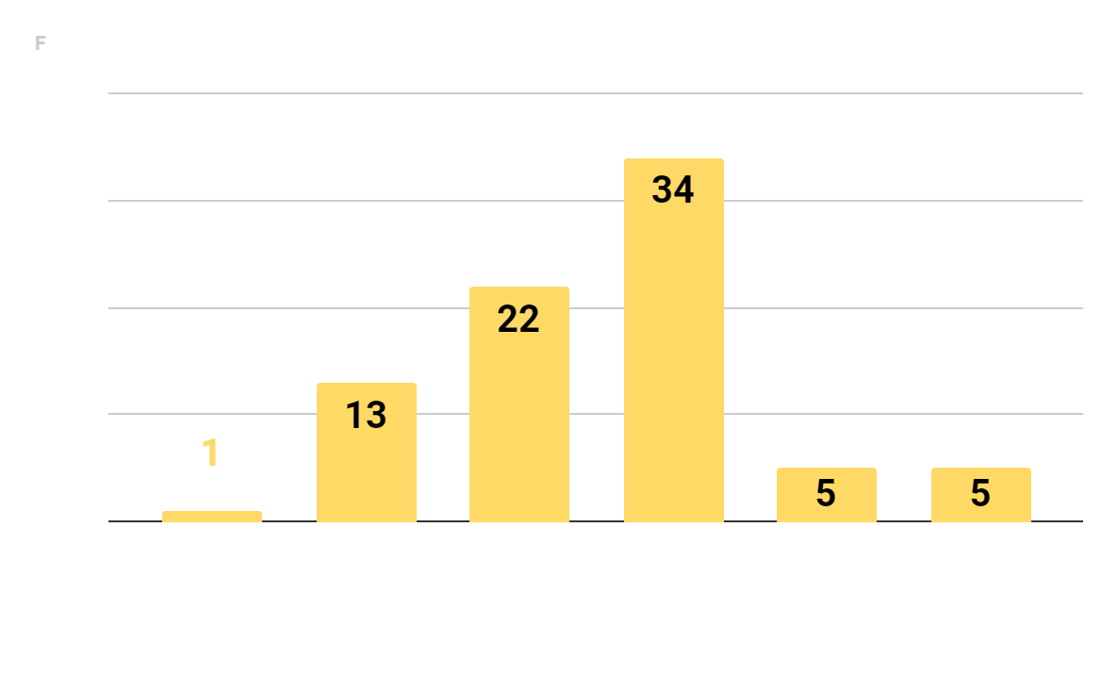
Justice and mental health treatment systems collaborate meaningfully to understand gaps in the justice system.[F]

Slide 17
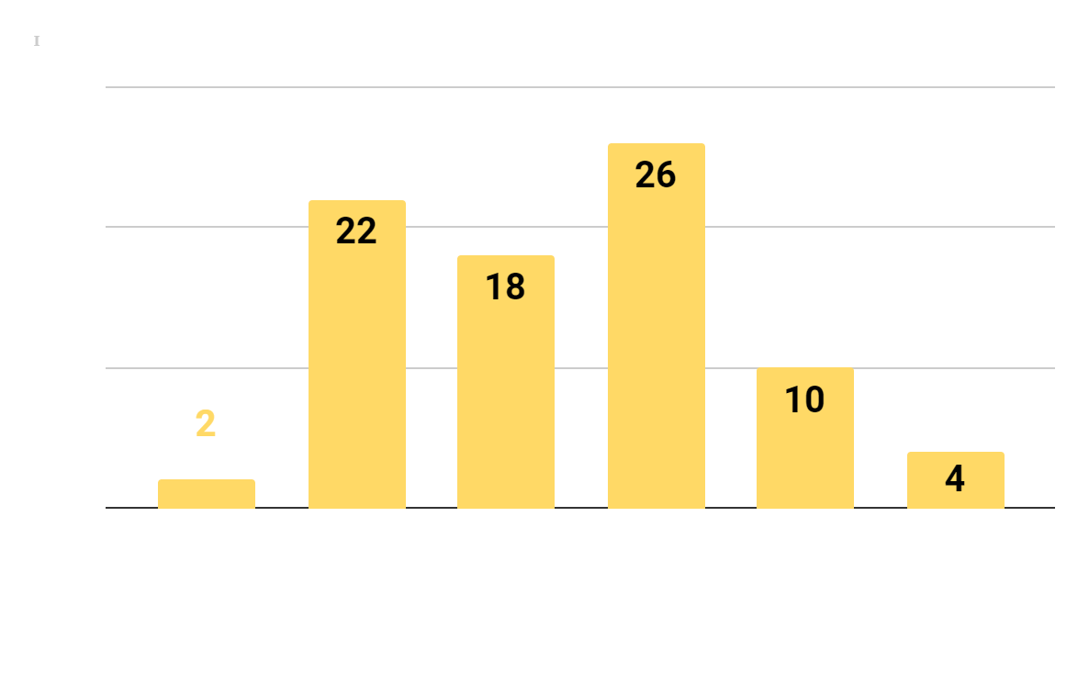
Stakeholders frequently communicate about mental health issues, including opportunities, challenges, and oversight of existing initiatives.[I]

Slide 18
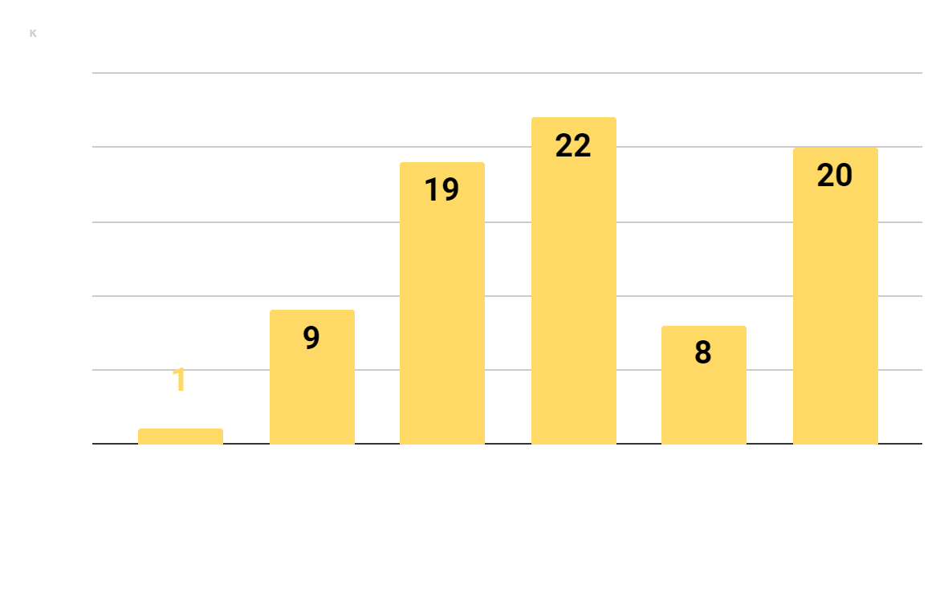
Stakeholders share data on a routine basis for the purposes of program planning, program evaluation, and performance measurement.[K]

Slide 19
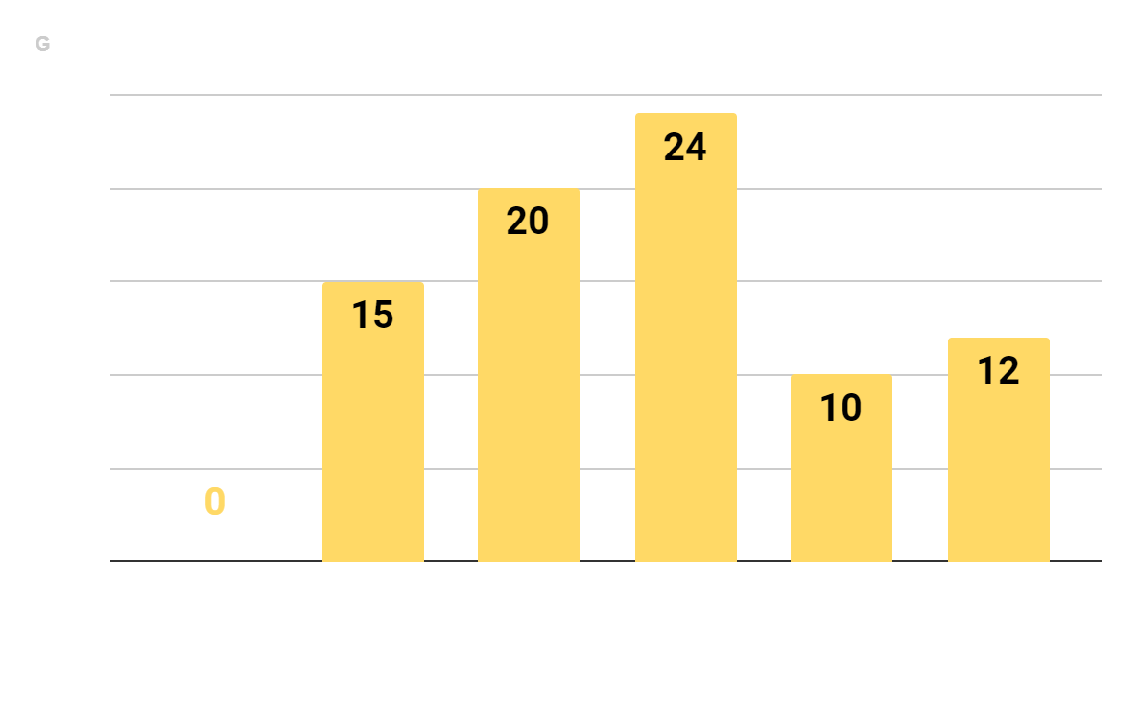
People with lived experience of mental health challenges, and their family members, are engaged as stakeholders on justice and mental health collaborations, such as committees, task forces, advisory boards.[G]

Slide 20
Identify and Implement Solutions

Slide 21


Slide 22
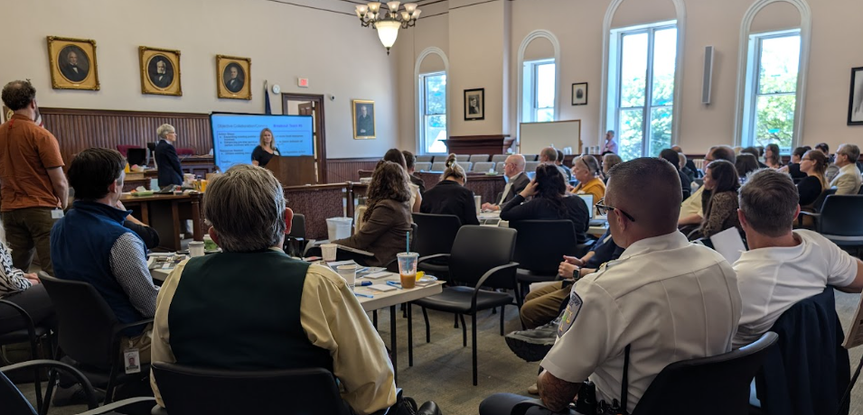

Slide 23


Slide 24
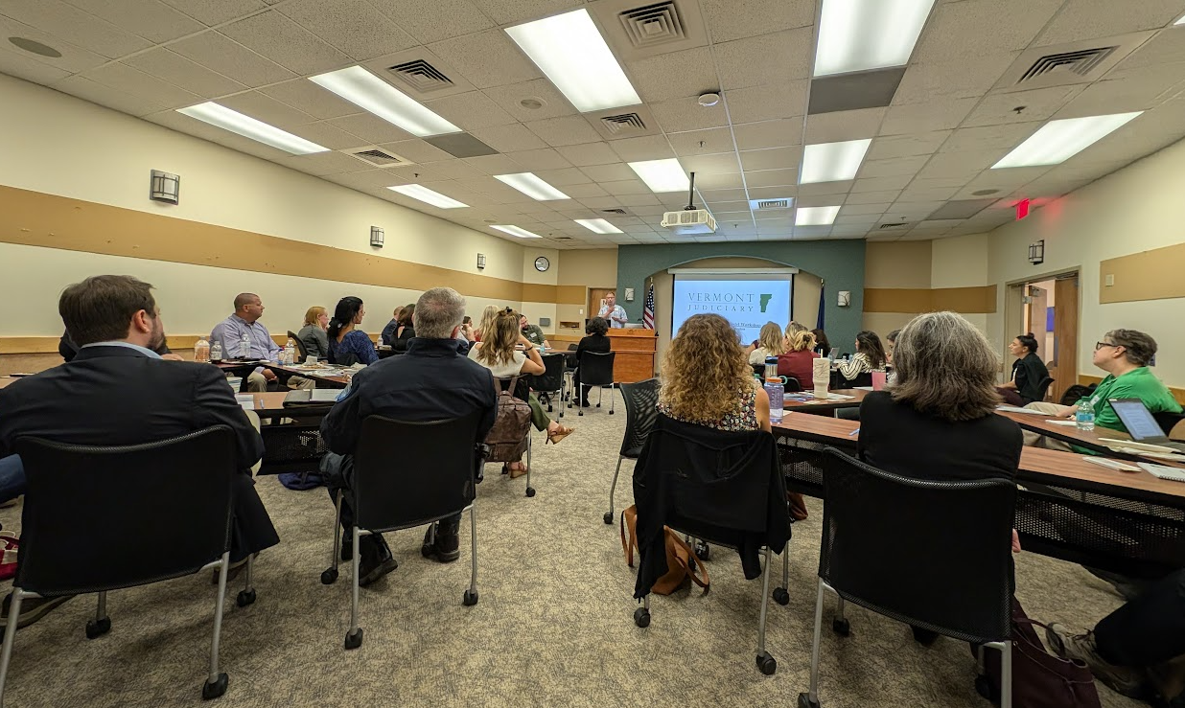

Slide 25
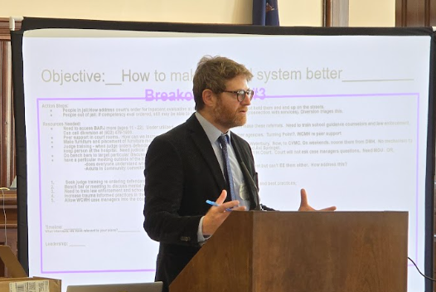

Slide 26
Strategic Planning (SIM) Resources:
  Community Surveys
  Data (SAMHSA, VDH, DMH, NIDA, etc.)
  SIM Model
  Expertise Around the Table

Slide 27
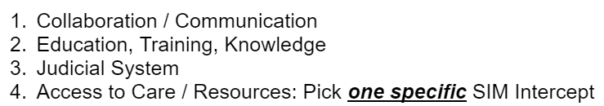
Areas of Focus

Slide 28


Slide 29
Example of Breakout Group Membership
Substance Abuse Counselor
Superior Court Judge
Probation / Parole Officer
EMS
Municipal Police Chief
State’s Attorney
Public Defender
Mental Health Agency Executive Director
Restorative Justice Coordinator
Peer Mentor
Housing SSA Program Manager

Slide 30
Objective: Community Awareness Breakout Team #4
Action Steps:
Design a community tour/orientation of services available in the community for newly assigned judges facilitated by DOC (site visits of key services and informational briefings)
Community orientation/tour for judges of local area
Change in judiciary policy to create default 2-year rotations – allowing greater familiarity with personnel, services, and cases
Integration of peer support personnel in court and/or training for court officers to help individuals experiencing high levels of stress during court appearances
Resources Needed:
Build a resource guide and “curriculum” for judge orientation
Consider options for peer support or other services to be available during key court dates (e.g. arraignment mornings)
Timeline: Implement by Spring 2025
What intercepts are most relevant to your plans? 3, 4
Leadership: Department of Corrections

Slide 31
Each group focused on three key areas.
Five groups in Northeast
Four groups in Northwest
9 x 3 = 27 Action Plan Outlines Focused on:
  Collaboration / Communication
  Education, Training, Knowledge
  Judicial System
  Adding Resources / Access to Care

Slide 32
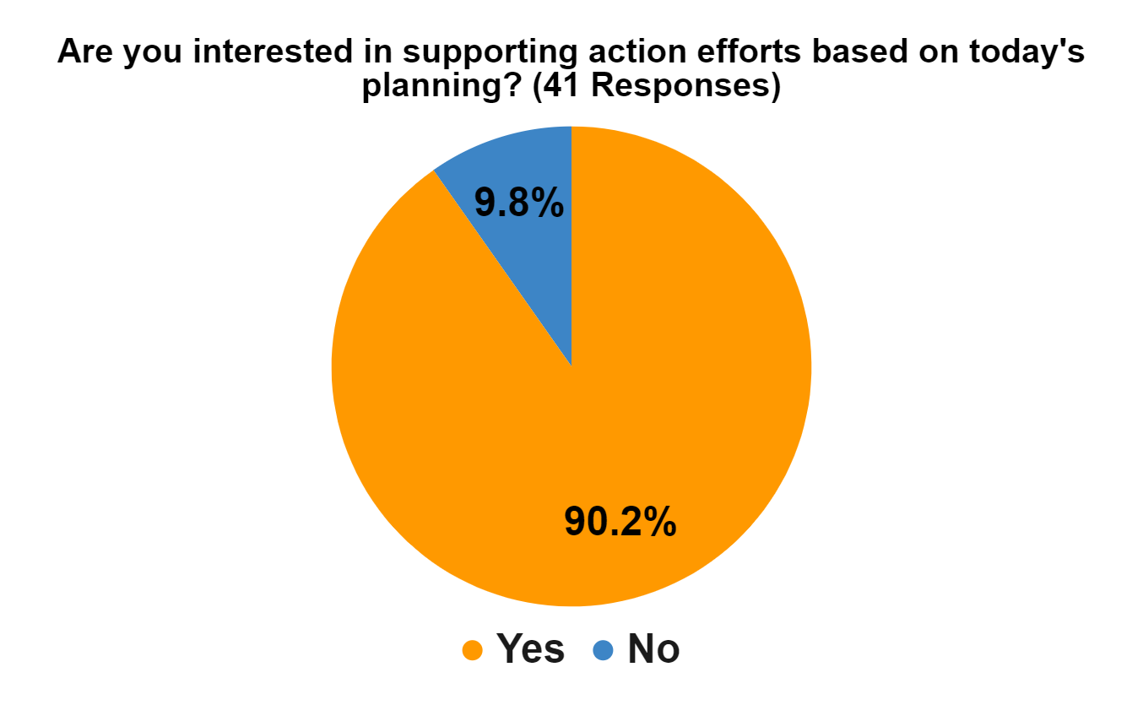
SIM Workshop Feedback Surveys: NE and NW Regions Combined

Slide 33
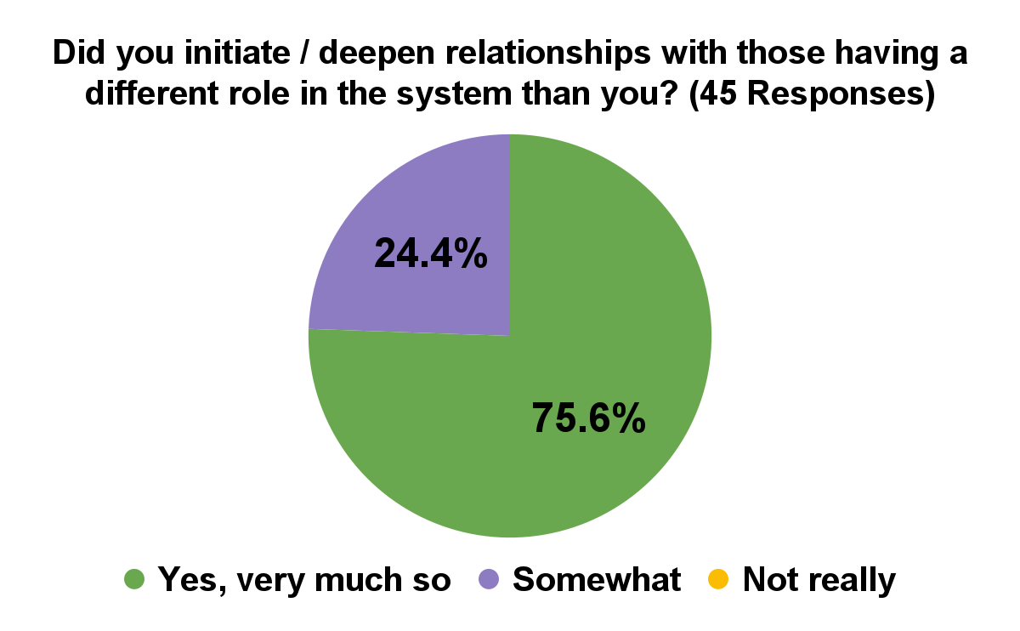
SIM Workshop Feedback Surveys: NE and NW Regions Combined

Slide 34
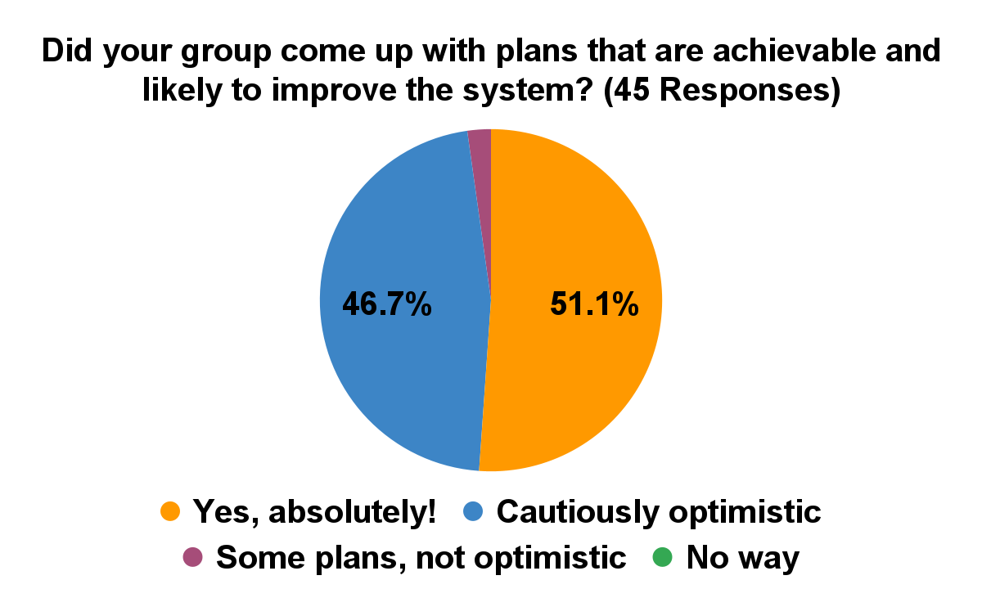
SIM Workshop Feedback Surveys: NE and NW Regions Combined

Slide 35
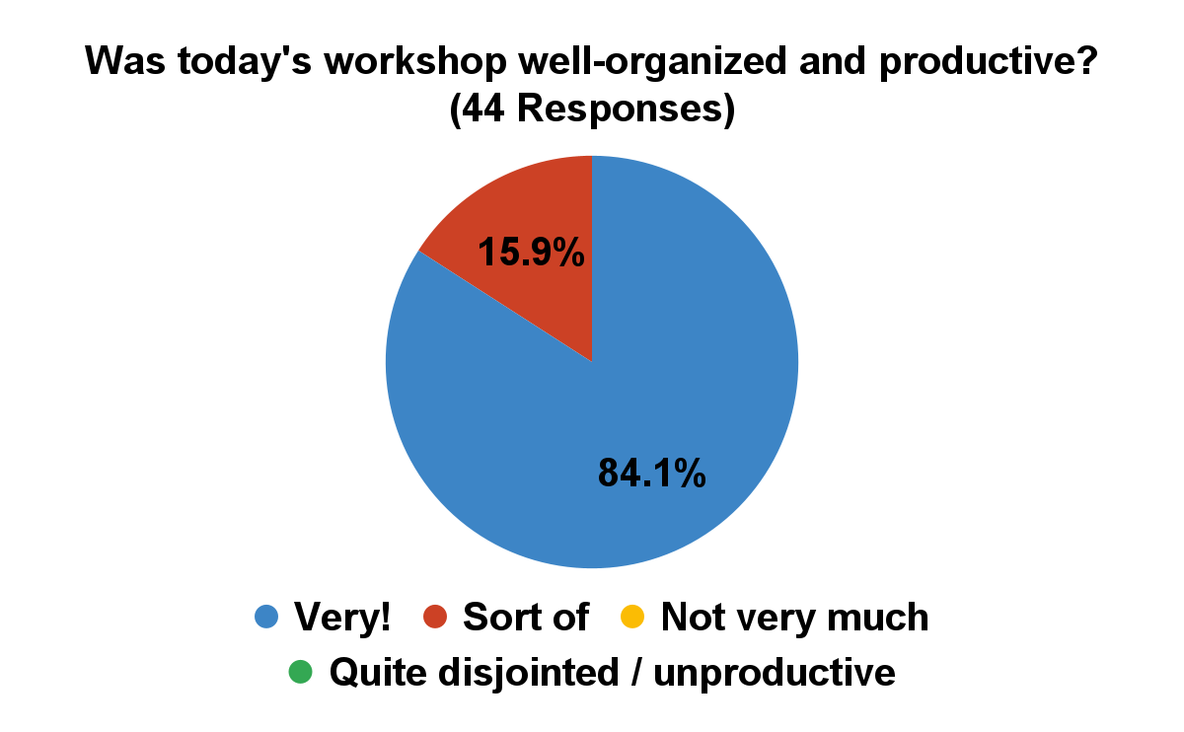
SIM Workshop Feedback Surveys: NE and NW Regions Combined

Slide 36
Ongoing Efforts in NE and NW Regions:
Follow-up workgroups are in organizational stages / starting to meet to accomplish workshop plans
Next Up: Three Judicial Regions
Southwest
Chittenden
Southeast
For those Next Three Regions:
Planning starts before the holidays
Workshops: April - May, 2025

Slide 37
CONTACT:
Judge Kate Hayes
kate.hayes@vtcourts.gov
Scott Acus
scott.acus@partner.vtcourts.gov

