Slide 1

“Accountability Court/Docket”
now the…“Rapid Accountability Docket” (RAD)
Timothy Lueders-Dumont, Exec. Director, Dept. of State’s Attorneys and Sheriffs
From Pilot-Project to Statutory Docket (Act 165)
(Oct 2025—June 2026 – 90 day surge events / temporary pilots
  in Chittenden (Oct 25-Feb 26)
  and Rutland (March 26-June 26)
  have now been formalized under Act 165 (July-Oct 26) into a permanent statewide model (now in Windham).
Core strategic goals: compress time between arrest, first appearance, and case resolution to interrupt repeat‑offense cycles with direct human services access.
System focus: high‑volume repeat defendants who drive a disproportionate share of statewide backlog.
Dec. 2025 Context
Defendants with 3+ pending cases = 45% of all active dockets
600 individuals with 5+ pending cases (6% of defendants) account for 25% of total statewide caseload capacity.
Notes:
SAS supports accountability dockets by providing transportation services, victim advocates, administrative staff, and Deputy State’s Attorneys. While these functions are not cost‑neutral, the only additional expense incurred to date beyond normal staff time has been overtime for the SAS Transport Program, driven by accelerated timelines and increased transport demands across three counties.
SAS caseloads—300–350 per attorney, 600 per victim advocate, and 800 per administrative professional

Slide 2
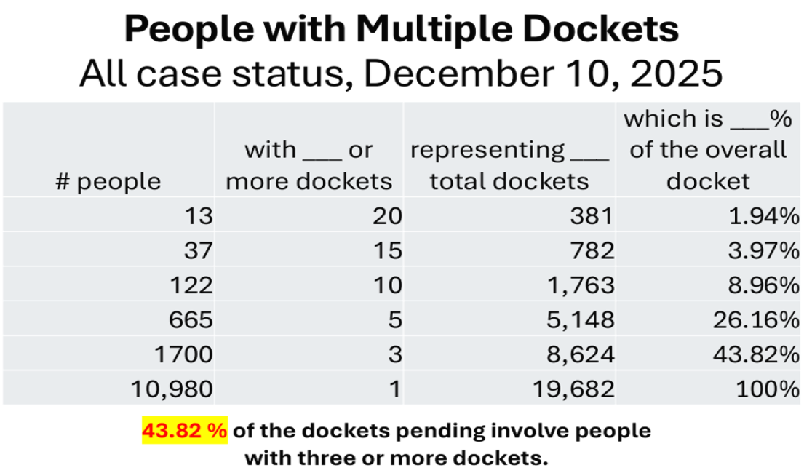
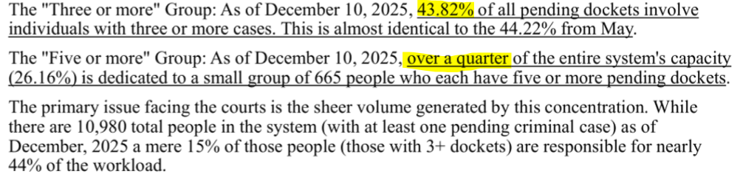
Three-or -MORE? & FIVE-OR-MORE?

Slide 3
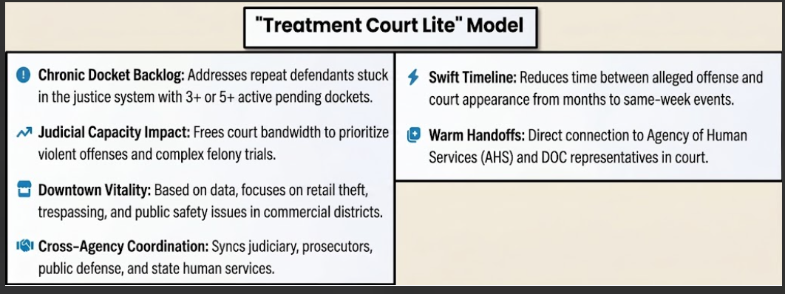

Slide 4
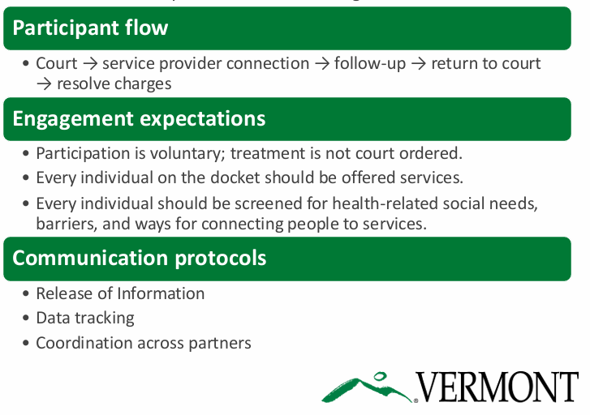
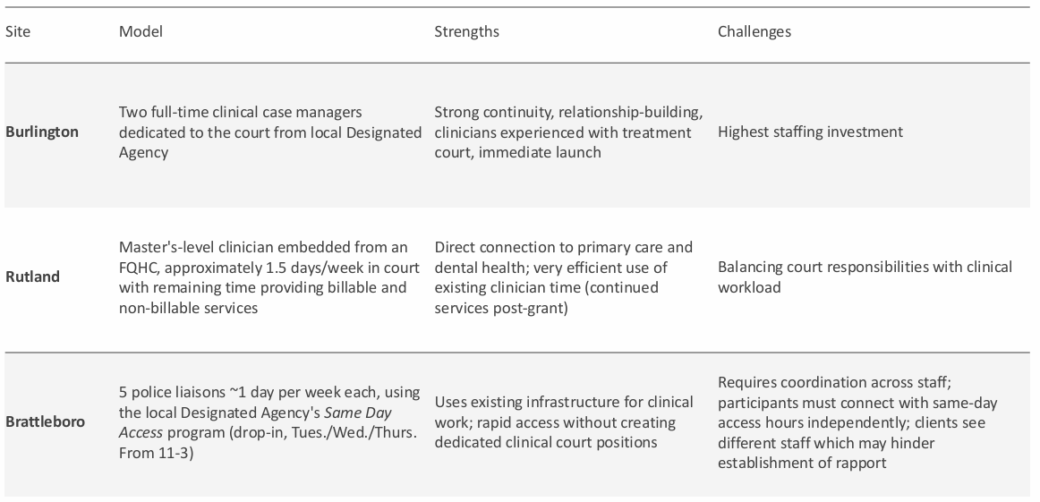
Rad & Human Services

Slide 5
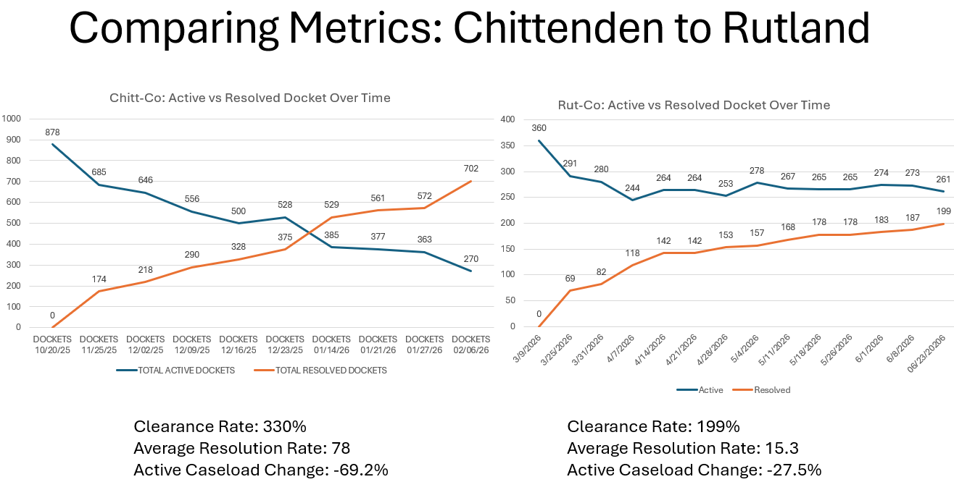
TLD SLIDE
Notes:
Chittenden County
• Active pending dockets reduced from 878 to 270 (69% reduction in <4 months).
• Chronic repeat caseload returned to pre‑pandemic baseline.
Rutland County
• Misdemeanors over goal: ~50% reduction.
• Felonies over goal: 38.9% reduction.
• Total active docket (incl. VOPs): 21% reduction.
Windham County
• Early trendlines after July 2026 launch show similar steep declines in repeat‑offender caseloads.

Slide 6
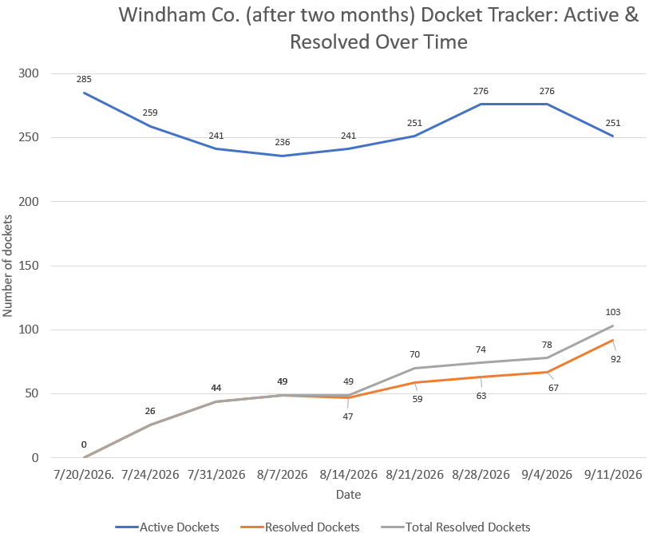

Slide 7
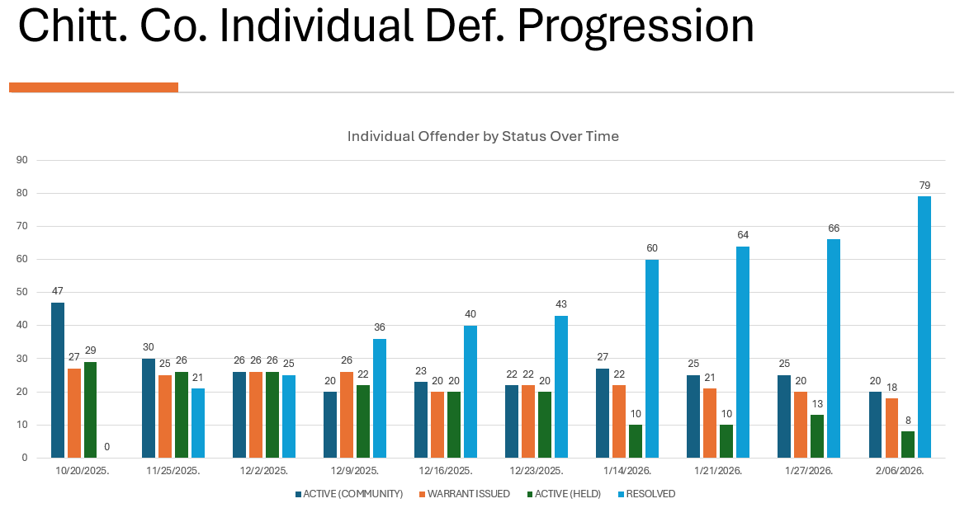

Slide 8
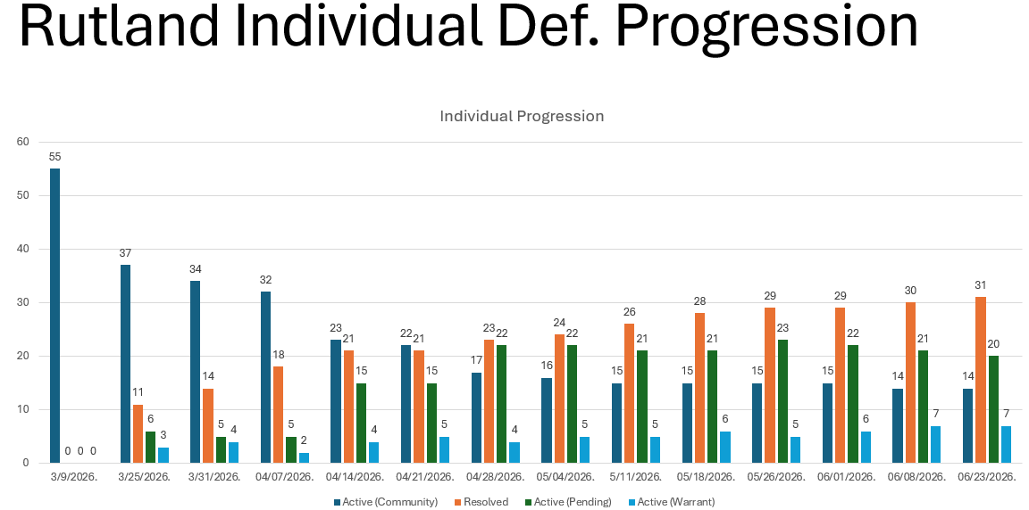

Slide 9
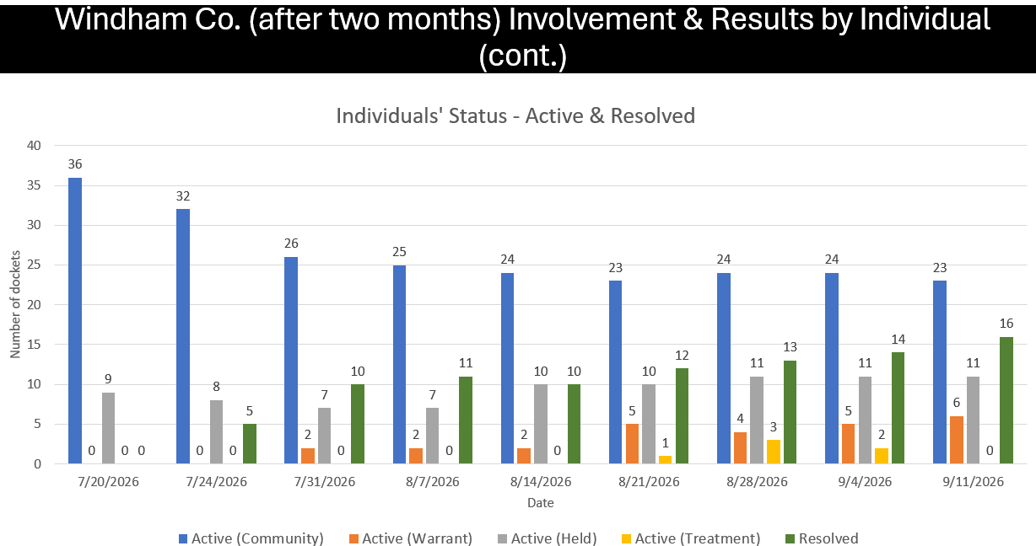

Slide 10
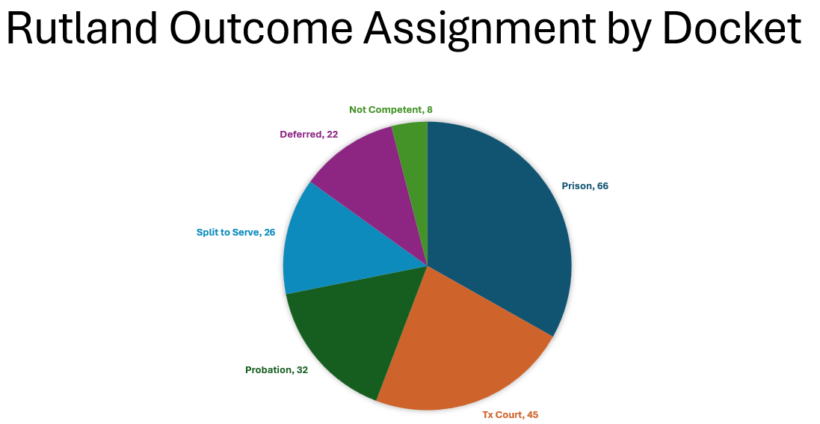

Slide 11
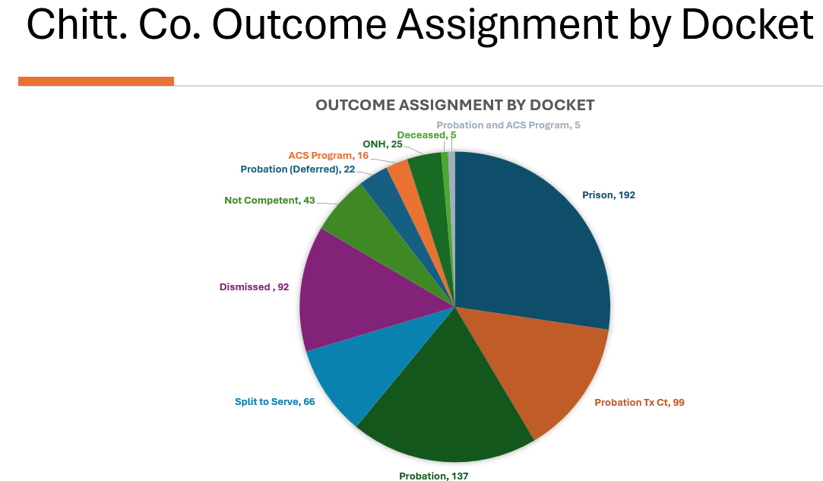

Slide 12
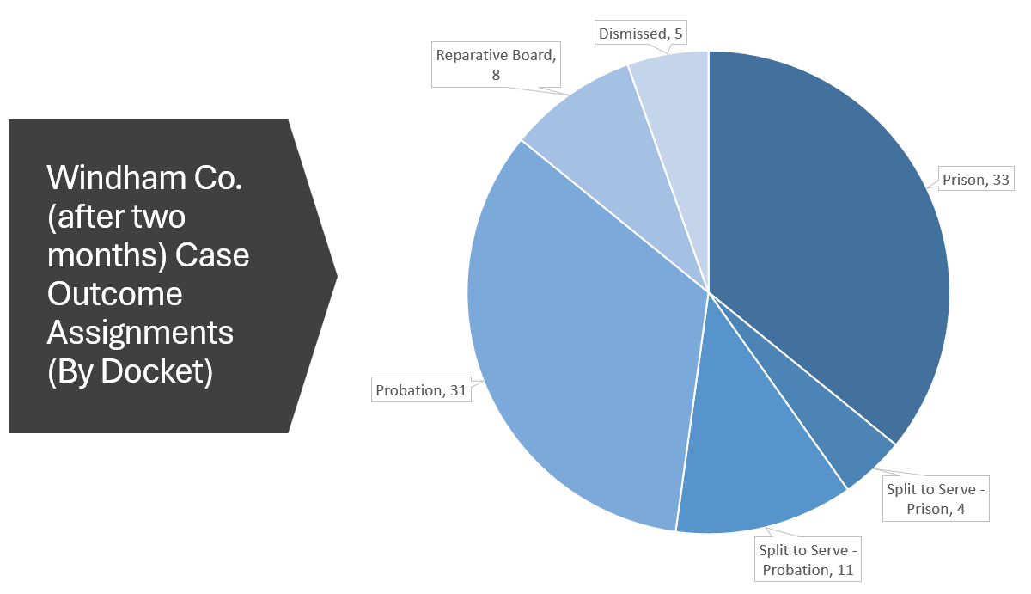

Slide 13
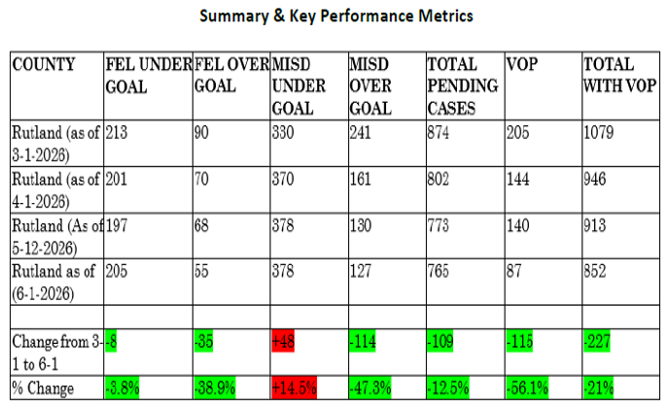
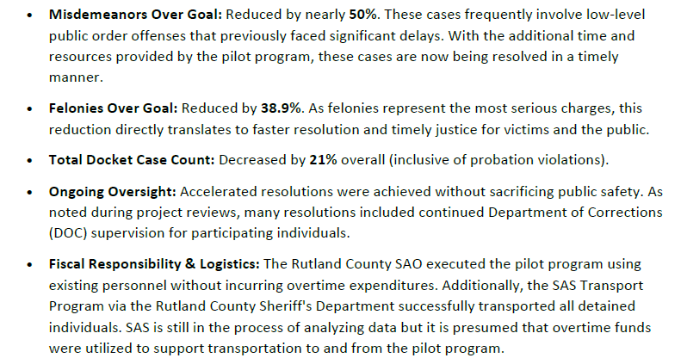
Rutland County Accountability docket
(Pilot #2)
TLD SLIDE

Slide 14
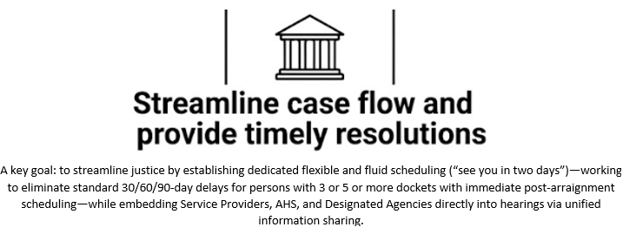
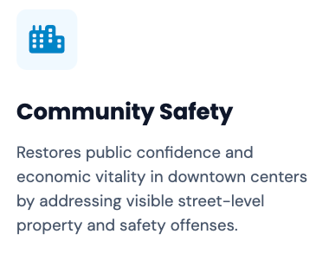
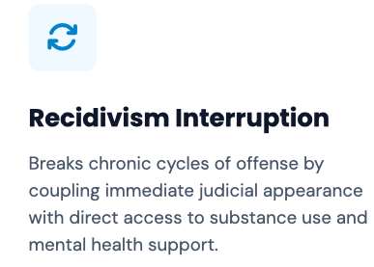
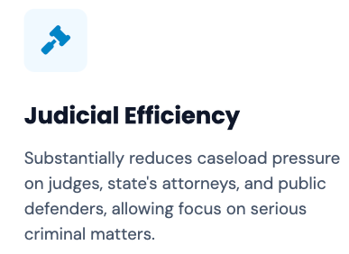
TLD SLIDE

Slide 15
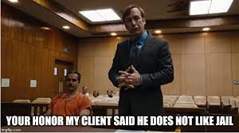

How was this Docket(s) created?
Tri-Branch collaboration
• Launched via two pilots (Chittenden (Fall 2025), Rutland (March 2026) and one statutory launch (Windham under (July 2026 law)).
• Formed through coordinated partnership: the Judiciary, State’s Attorneys, Sheriffs, the Dept. of State’s Attorneys & Sheriffs, AHS (incl. DOC), Defender General, and Governor’s Office. Now – Legislature – via Act 165.
• Created to address and focus efforts on 3–5+ pending cases.
• Chittenden surge included a dedicated retired judge and a Special Prosecutor focused on high‑volume repeat defendants.
• Former pilot model is now a statutory rapid accountability docket (Windham).

Slide 16
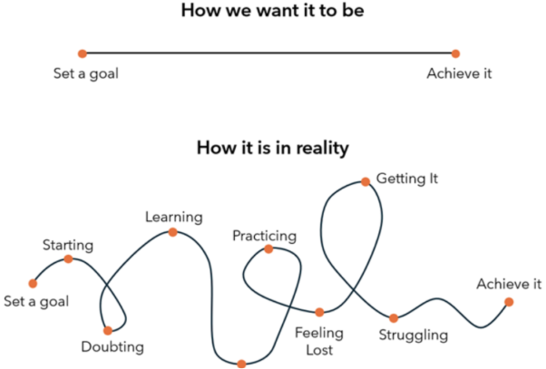
Chittenden County (Pilot)—Fall 2025—early spring 2026
Rutland County (Pilot)—Spring 2026—Summer 2026
Windham County (Act 165 docket) Summer—Fall 2026
Where will RAD GO NEXT?????!!!
PS = RAD = how court should be!?

