Slide 1
Navigation Tablets
VT Judiciary Commission on Mental Health and the Courts
Fourth Annual Summit
9-24-2026

Slide 2
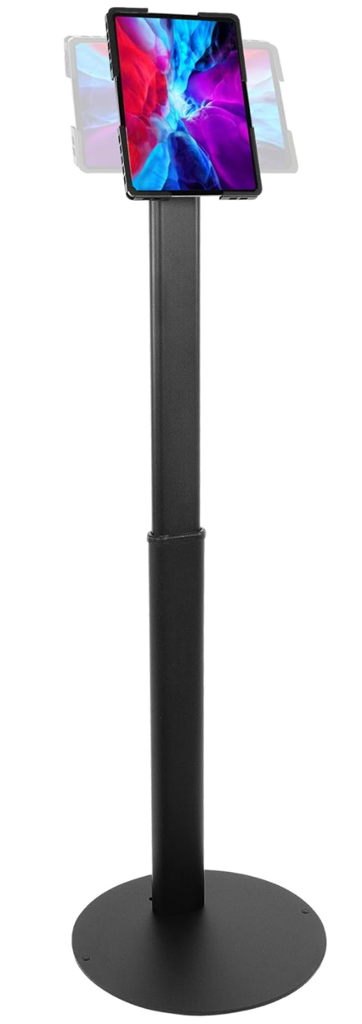
Project Proposal
Navigation Tablets
A recurring goal of the Vermont Judiciary Commission on Mental Health and the Courts is “to advance the pursuit of equal justice under the law,” and one of the goals that came out of last year’s Mental Health and the Court’s summit was a commitment to improve the ability of justice involved individuals to navigate mental health/substance use services in their community.
Additionally, we received feedback at every SIM workshop that easily accessible resource guides or lists for locally available mental health/SUD resources would benefit each region’s respective community.
To that effect, we are pursuing the development and implementation of dual purpose tablets that could be placed in courthouses and willing community locations to provide litigants with easily accessible information regarding local mental health/substance use providers and access to remote hearings.

Slide 3
Basic Details
Navigation Tablet
What? — A simple and easy to operate consumer grade android tablet attached to an anti-theft stand for accessing hearings and local services.
Why? — Provide cost free access to information on local mental health/substance use services, the ability to call them free of charge, and access to remote hearings statewide.
Who? — Litigants with limited access to cell phones, connectivity or transportation, and who may have mental health or substance use concerns.
Where? — Courthouses and partner locations (town halls, treatment providers, etc) as selected on a county-by-county basis by assistant judges in their role as county administrators, starting with Rutland.
How? — Funded by SCIP grant passthrough money requested by the county, with Judiciary to provide technical and logistical assistance to facilitate project rollout. Daniel & IT to coordinate design and installation, with the Access Resource Center to provide remote troubleshooting.
When? — Federal pass through funding expires September 2027.

Slide 4
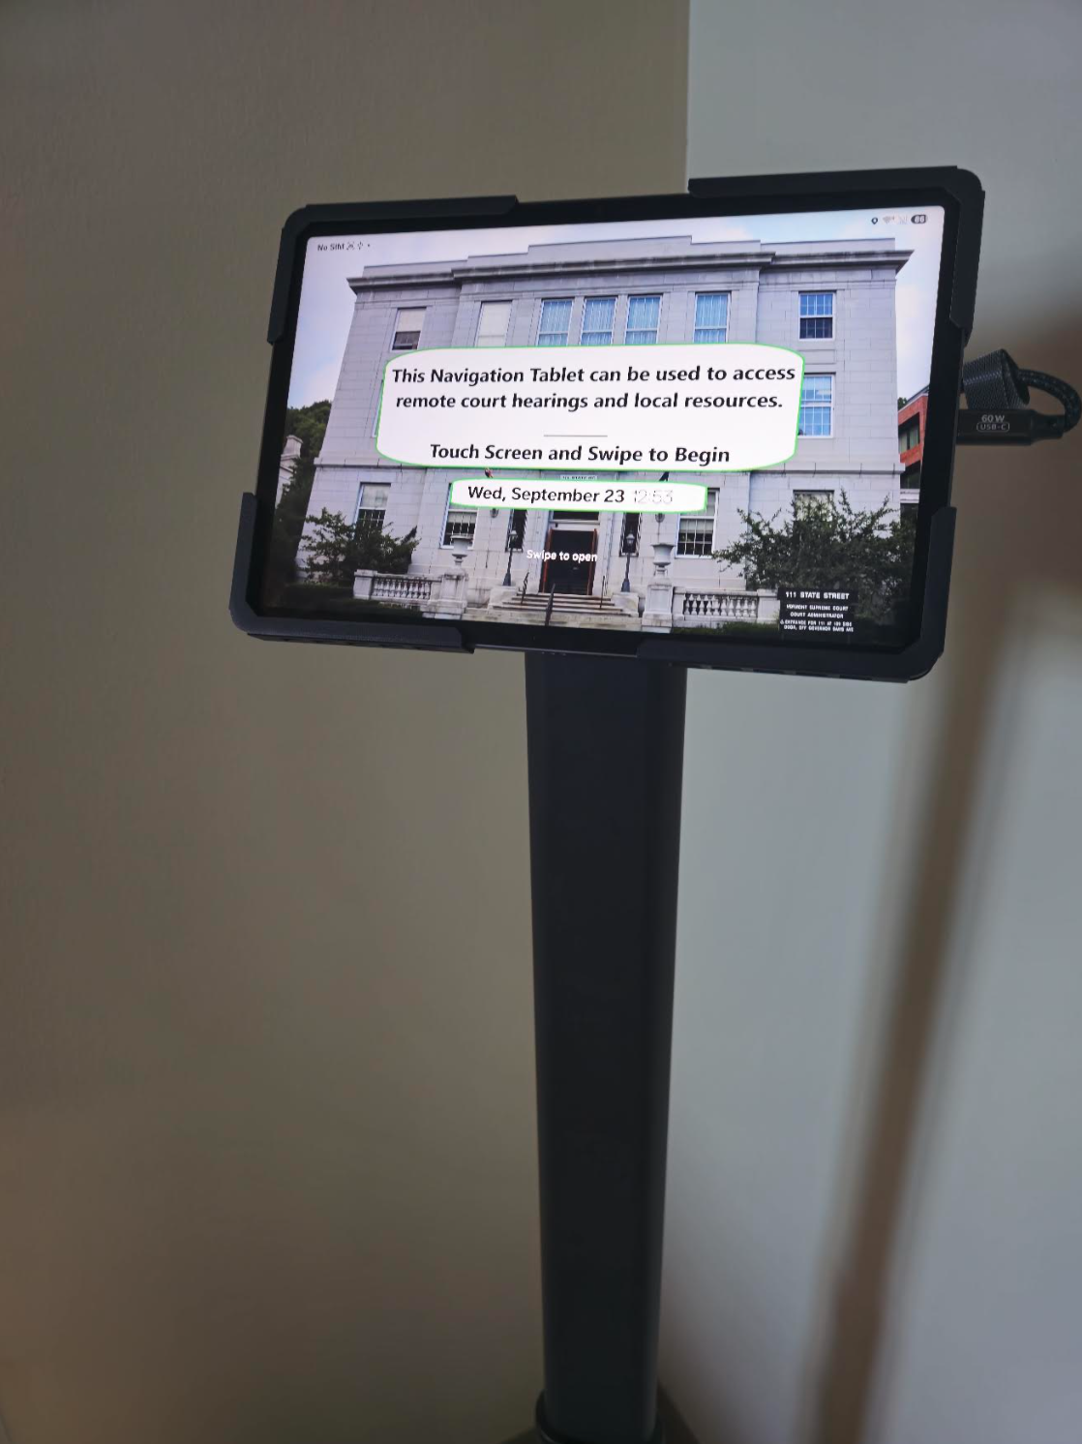
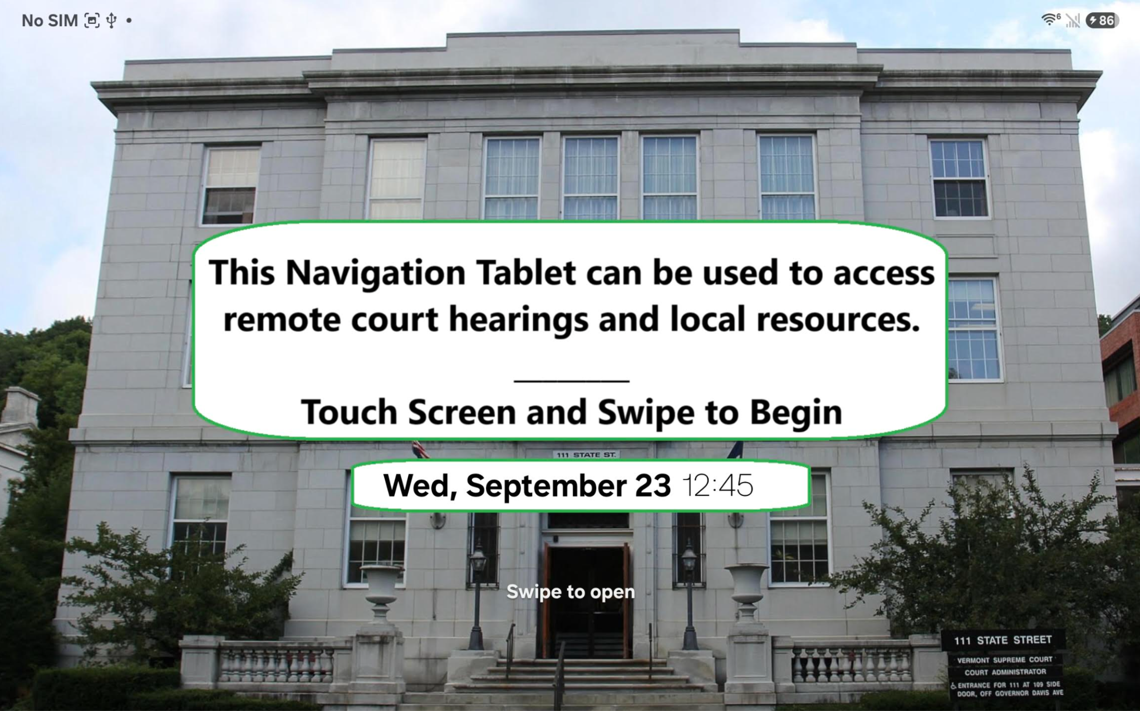
Home Screen
Navigation Tablet

Slide 5
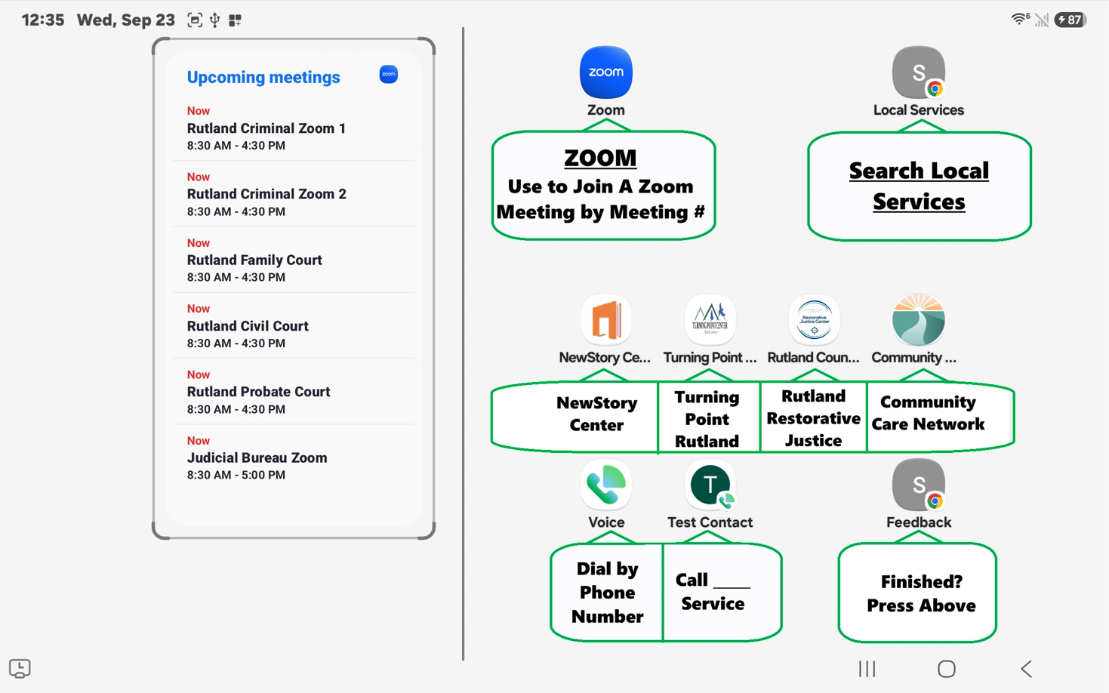

User Interface

Slide 6
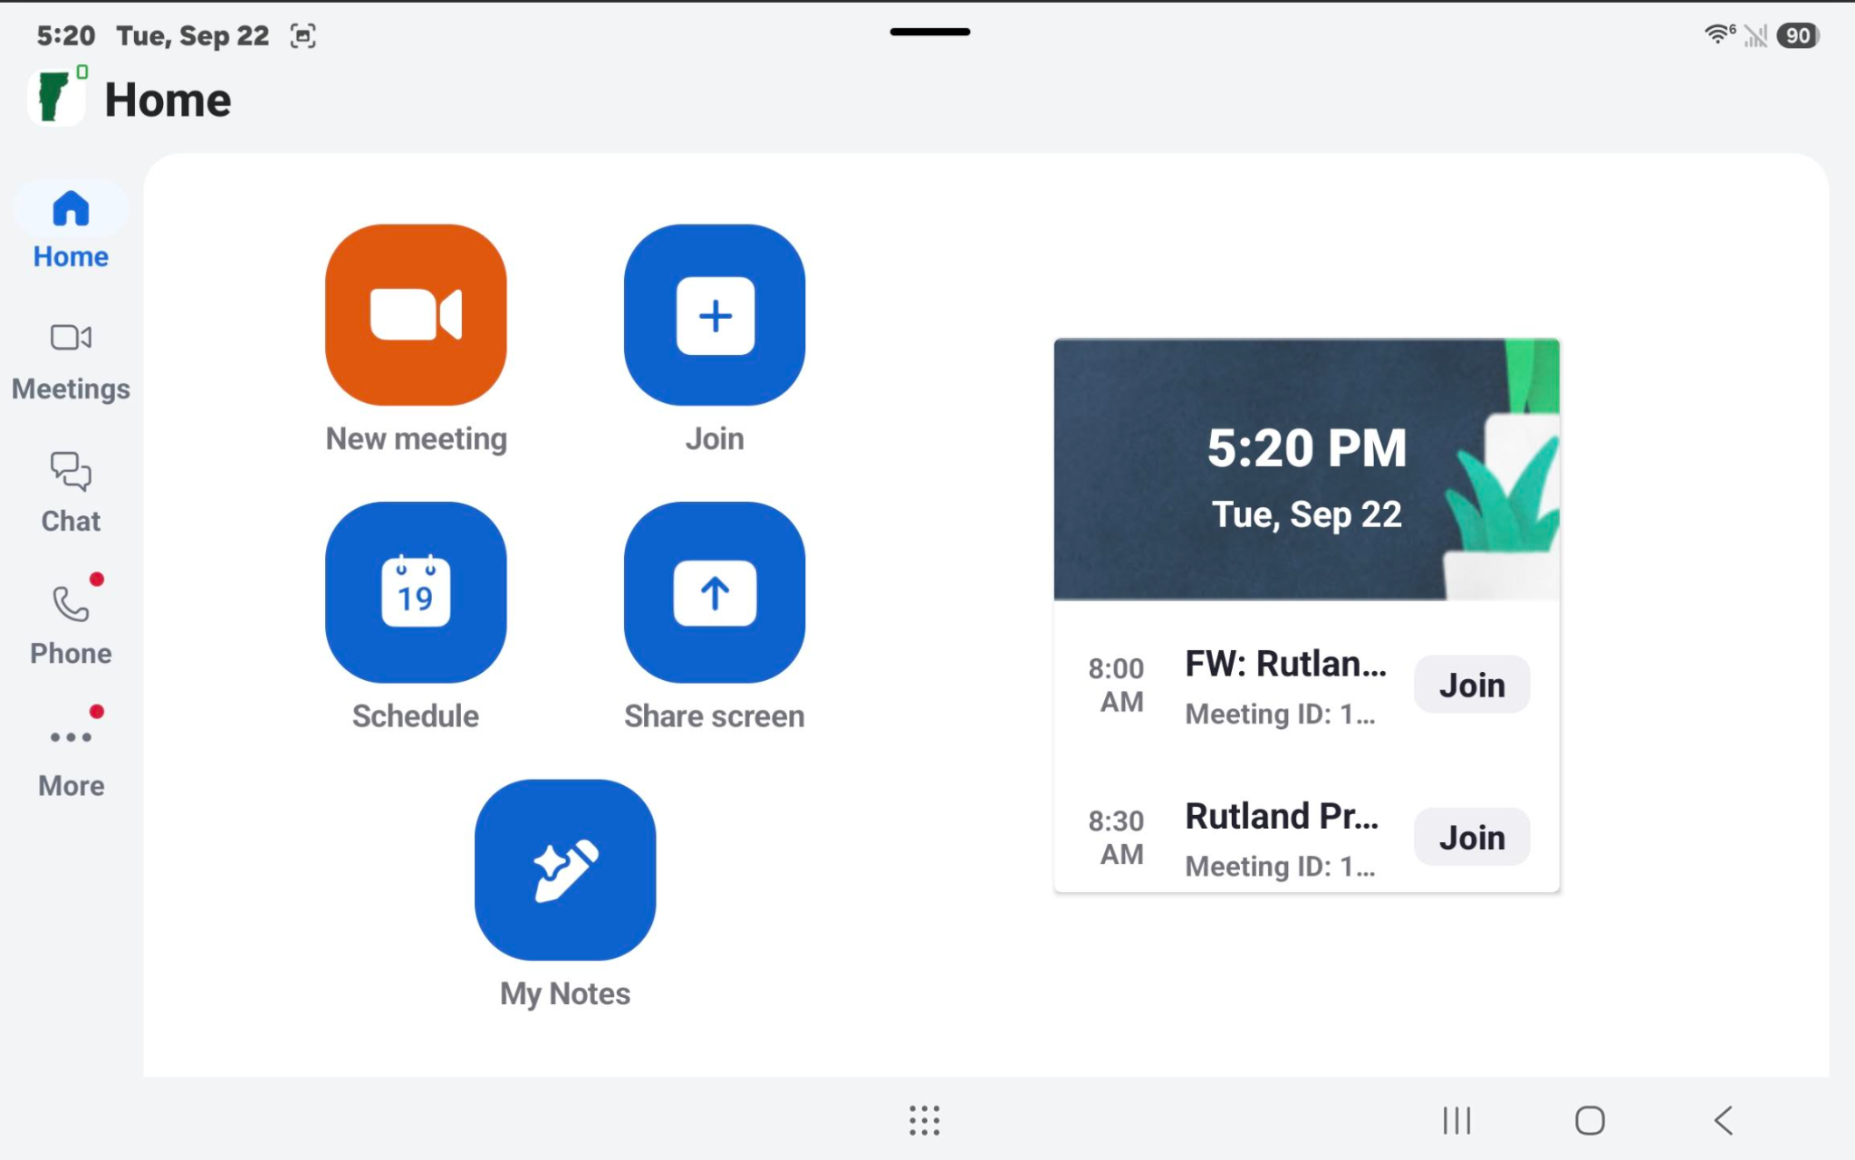
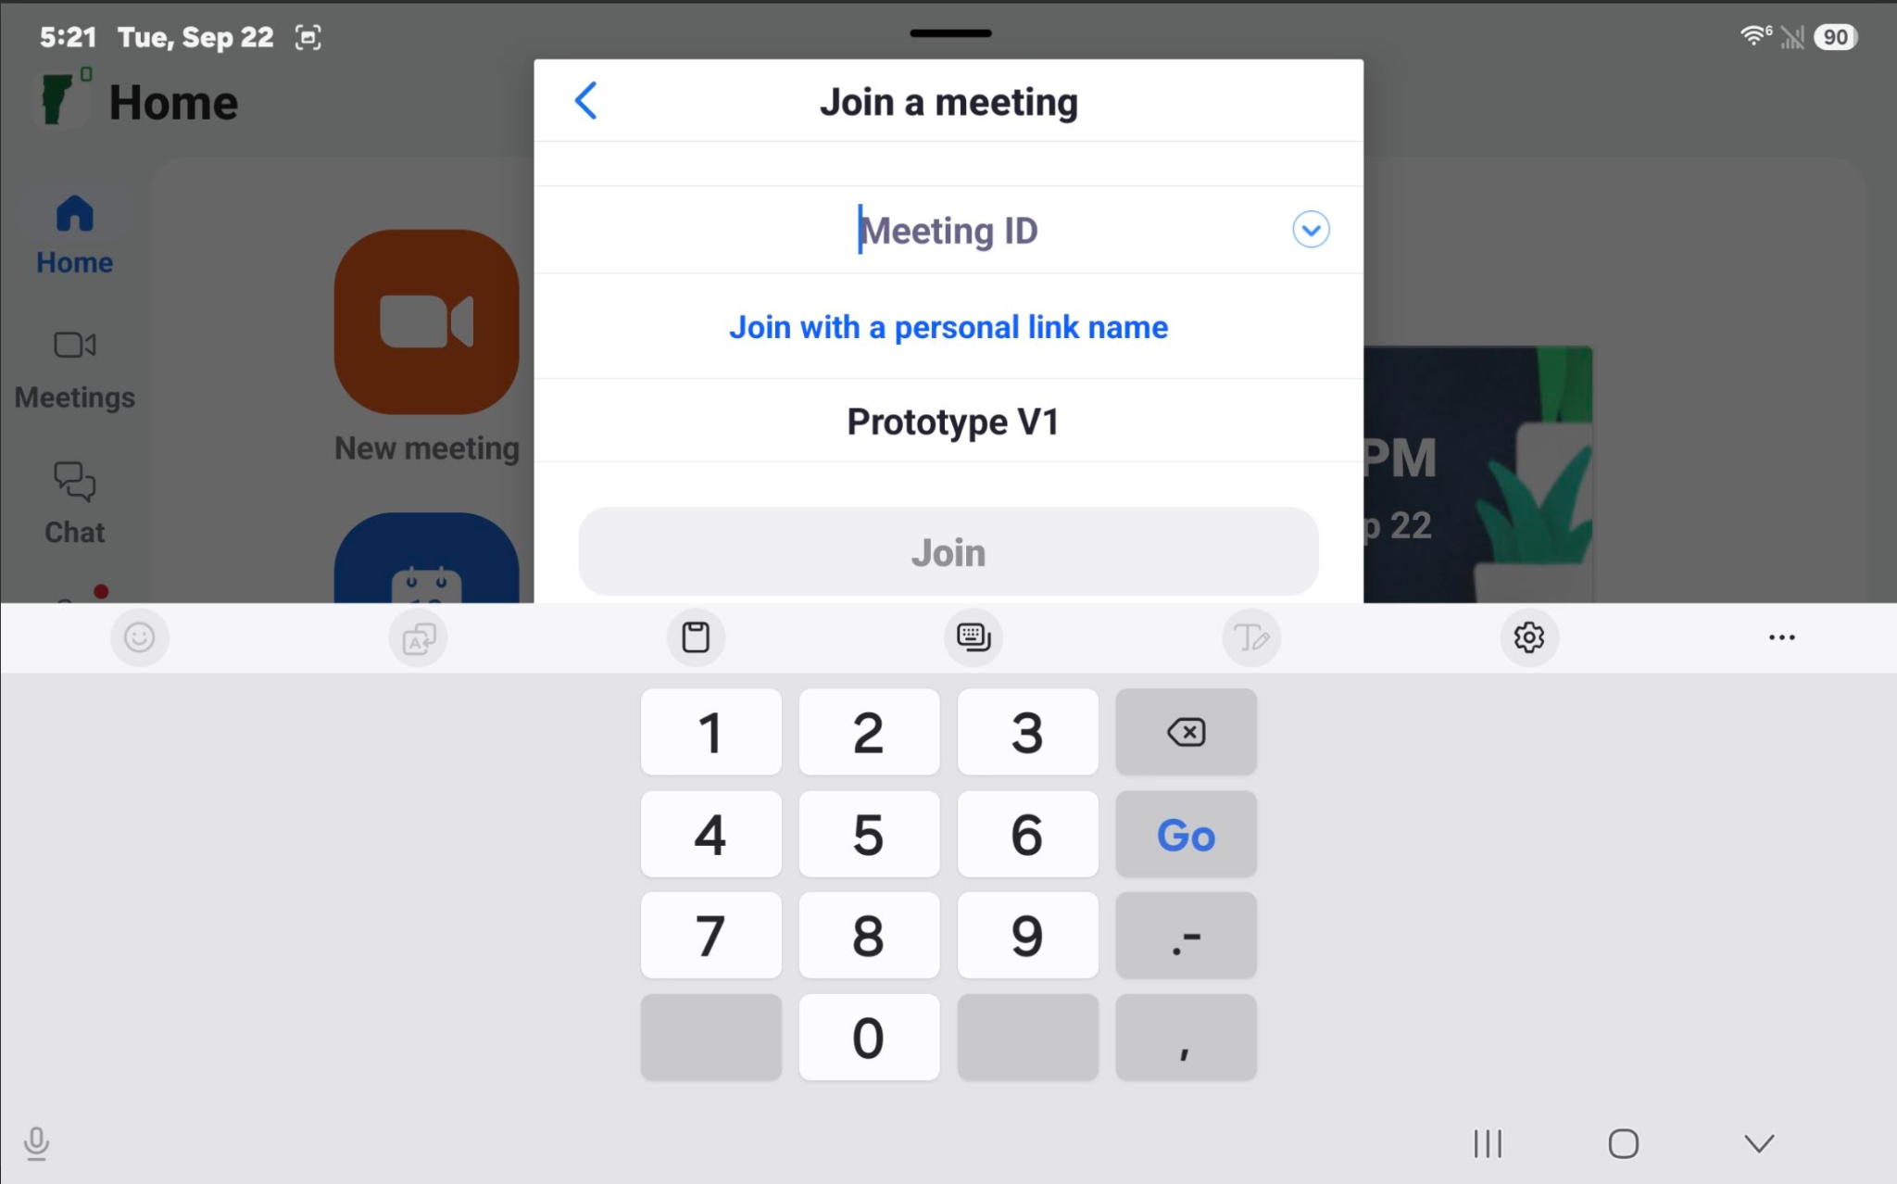
User Interface - Zoom

Slide 7

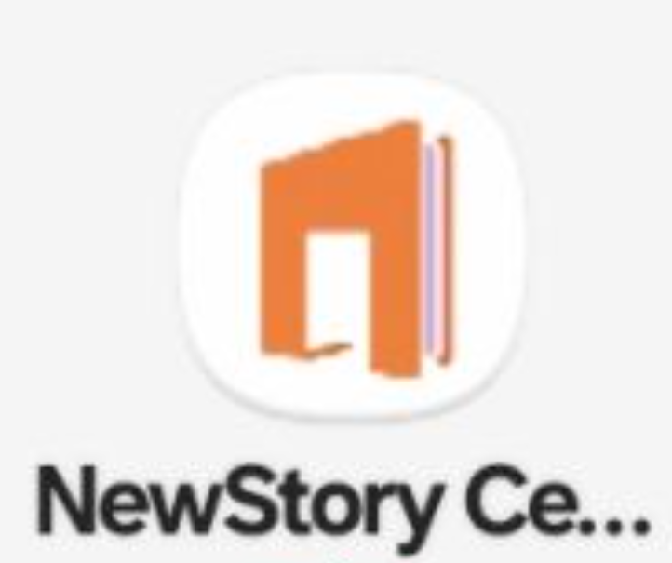




User Interface

Slide 8
Why Is This Important?
Simply knowing what services are available in their community is often one of the biggest stumbling blocks for individuals who are struggling with mental health or substance use issues.
Individuals who are struggling with mental health, substance use or homelessness often lack the time, ability or technical resources to easily research what community resources are available to them.
This tablet mitigates those factors by having information available free of charge, using consumer grade technology that people are likely to be familiar with, with a user interface configured for minimal button presses and navigation.
This tablet facilitates access to services at a crucial time when individuals are both most likely to need them, and willing to engage with them.

Slide 9
Why Is This Important?
Facilitating this access carries an intrinsic message to those involved with the justice system that the court wants them to have good outcomes and have access to the resources they need to succeed.
An individual who finds access to a homeless shelter, food bank or treatment through a navigation tablet may be less likely to view the court as an adversarial entity, and more likely to engage meaningfully in proceedings.
With the increased prevalence of remote hearings and the inability of some litigants to connect to remote hearings because of a lack of equipment and/or wifi connectivity, the tablets offer the means for those litigants to connect.

Slide 10
Overview of Process
Identify participating county
Identify tablet locations in county
Identify local resources/providers to display
Submit grant application using approved template
Install tablets and provide training
Publicize availability of tablets throughout county

Slide 11
Questions?

